Slide 1
Up Funds-Mutual Fund Management System
Project Innovation through Code Contest and Presentation
Group 8
Batch 12
OFSS, Bangalore
Presented By: Ayush, Saket, Jaideep

Slide 2
INTRODUCTION
Revolutionizing ABC Mutual Funds, this project entails a web app tailored for Portfolio Managers (PMs) to craft and oversee Mutual Funds (MFs) with unique stock portfolios and attributes. Investors access the platform to view MFs, check prior day's NAVs, invest and redeem units, and review portfolios and transactions. The system calculates NAVs using pre-set share prices and flexibly adjusts business dates for precise transaction processing and NAV calculations.

Slide 3
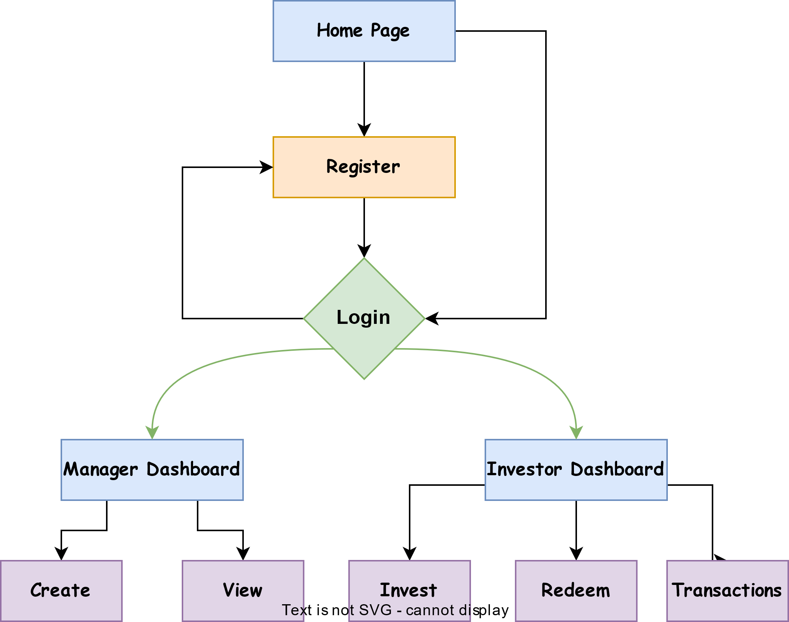
COMPONENTS
Not Registered
Already Registered
Authenticated

Slide 4

REQUIREMENTS
User Roles and Authentication
Portfolio Manager Features
Investor Features
Net Asset Value Calculation
User Interface
Data Management
Security & Privacy

Slide 5
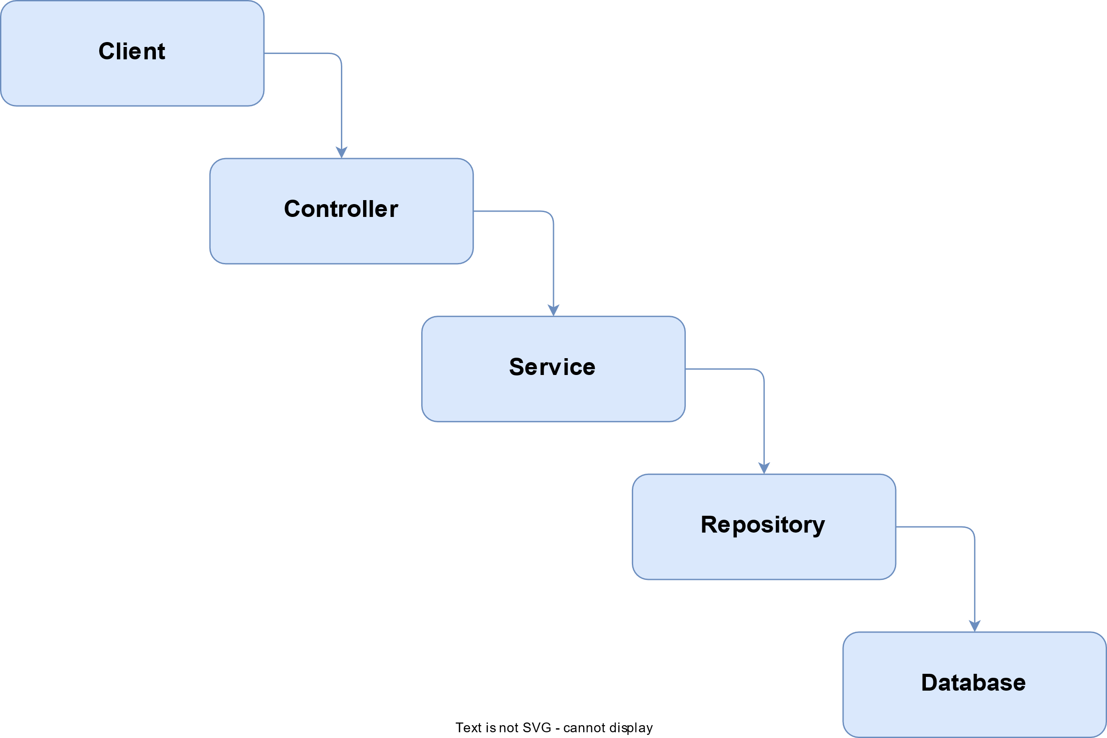
Backend Workflow

Slide 6


TECH STACK
Server Side
User’s Browser
Spring Boot
React Js
Java
Javascript
Oracle DB
Html / Css

Slide 7
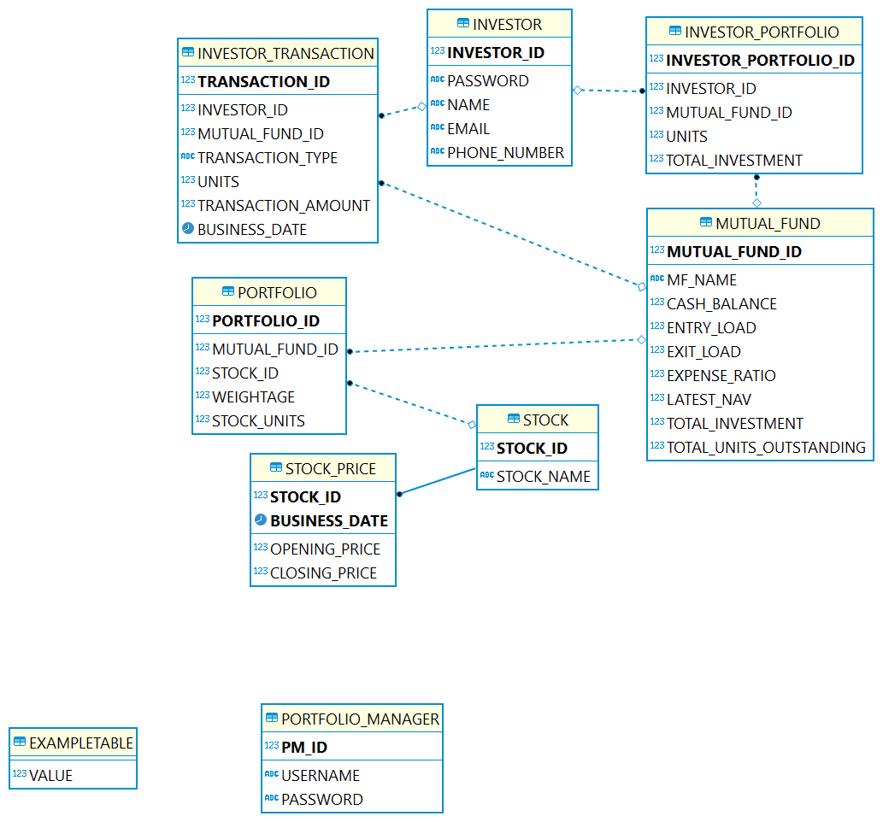
ER DIAGRAM

Slide 8
Thank you
Presented By:
OFSS, Bangalore

